Slide 1


Nagarjuna college of engineering and technology

Slide 2
Real-Time Motion Detection with OpenCV and User Alerts via Twilio
Md .Haroon Mayank Singh Riteesh M Madhu Y
[1NC21CI028] [1NC21CI030] [1NC21CI040] [1NC21CI056]

Slide 3



Content
Abstract Introduction Objectives Flowchart Implementation
Future Enhancement & Challenges Conclusion

Slide 4
Abstract
This paper presents a real-time motion detection and video recording system using OpenCV and Python. The system captures live video from a webcam or a specified video file, detects motion, and records video only when motion is detected. The motion detection is achieved through background subtraction and contour detection. When significant motion is detected, an SMS notification function is triggered, and the video recording begins, creating a new video file named with a timestamp for easy organization. The recording stops after a period of no motion to conserve storage space. The system ensures efficient storage management by implementing a minimum contour area threshold, recording duration control, and appropriate video codec usage. Proper resource management techniques are employed to release video writer objects and capture resources to prevent data loss and ensure smooth operation.

Slide 5


Introduction to Motion Detection
Real-Time Motion Detection is a crucial technology in various applications, from security systems to smart home automation. This presentation will explore how to implement motion detection using OpenCV and send user alerts via Twilio. Let's dive into the exciting world of computer vision!

Slide 6
Objectives
OpenCV Basics: OpenCV is a powerful open-source computer vision and machine learning software library, widely used for real- time motion detection and analysis.
Motion Detection Algorithms: OpenCV provides various algorithms and methods for motion detection, including background subtraction, frame differencing, and contour detection.
Twilio API: An overview of Twilio's API capabilities for SMS, voice, and messaging services, providing a reliable platform for real-time alerting.
Storage Allocation: When motion is detected, a new video file is created to store the recording. Recording is stored with multiple snippets of only motion detected clips

Slide 7

What is OpenCV?
OpenCV (Open Source Computer Vision Library) is an open-source computer vision and machine learning software library. It provides a comprehensive set of tools for image processing, including motion detection capabilities. Understanding its functionalities is essential for implementing real-time applications.

Slide 8
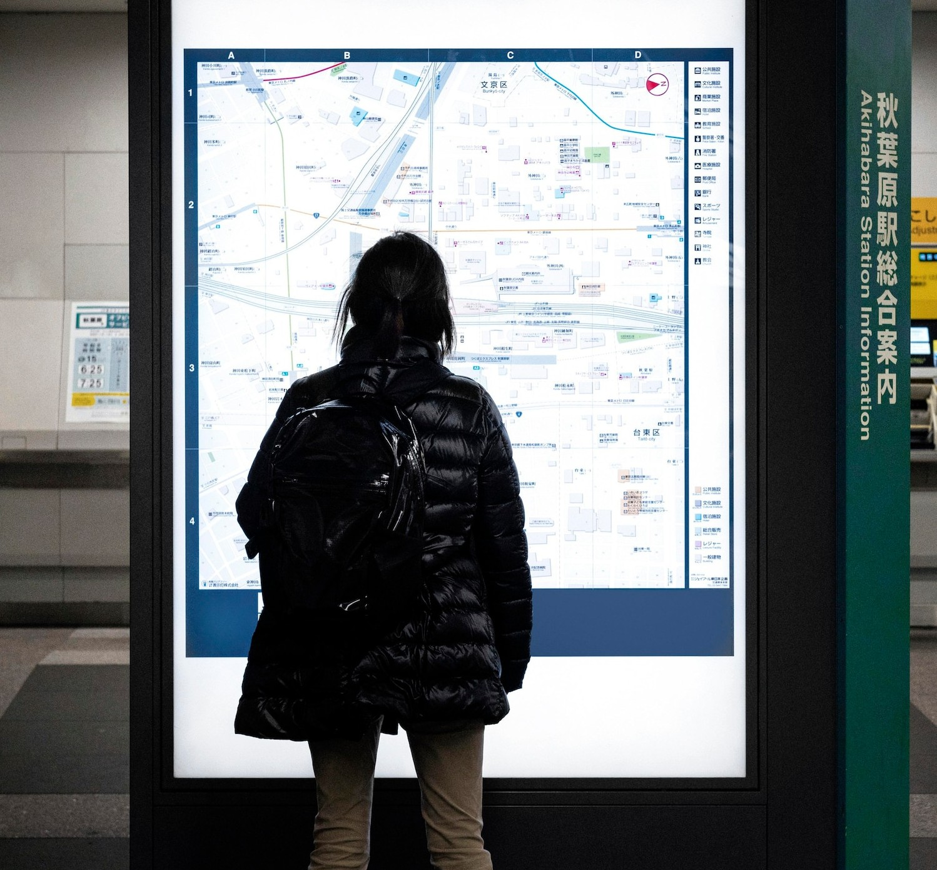
Implementations
Setting Up OpenCV
To get started with OpenCV, you need to install the library in your development environment. Use pip install opencv-python for Python projects. After installation, you can begin importing the library and accessing its powerful features for image and video processing.
.
Capturing Video Stream
You can capture video from a webcam or an IP camera using OpenCV. The function cv2.VideoCapture() allows you to access the video stream. This is the first step in implementing real-time motion detection. Let's see how to set it up in code.

Slide 9

Detecting Motion
Motion detection can be achieved by comparing consecutive video frames. By calculating the difference between frames, we can identify areas of movement. Techniques like background subtraction and contour detection are commonly used for this purpose. Let's discuss these methods.
To send alerts when motion is detected, we can integrate Twilio. Twilio provides APIs for sending SMS and notifications. By setting up a Twilio account and using their library, we can easily send alerts to users, enhancing the functionality of our motion detection system. Integrating Twilio for Alerts
Integrating Twilio for Alerts

Slide 10

Sending SMS Notifications
Testing the System
Once the motion detection and alert system is set up, thorough testing is crucial. Check for false positives and ensure alerts are sent promptly. Monitor the performance under different conditions to fine-tune the detection sensitivity and alert mechanisms.
Using Twilio's API, you can send SMS notifications directly from your application. The process involves creating a Twilio account, obtaining an API key, and using the Twilio library to send messages. This feature is essential for real-time alerts during motion detection events.

Slide 11
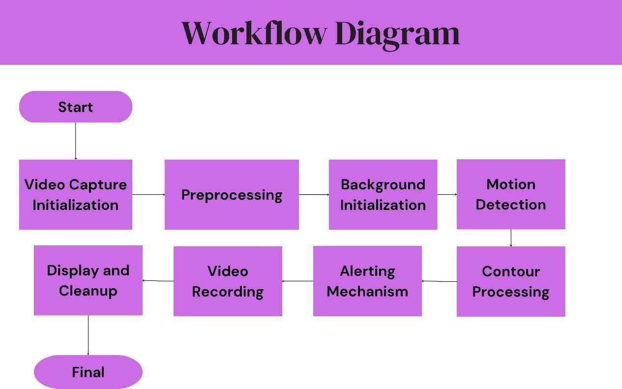

Slide 12

Challenges
Weather Conditions: For outdoor applications, weather conditions like rain, fog, or snow can introduce noise and reduce the reliability of motion detection.
Integration with Other Systems: Integrating this system with larger security or monitoring setups, including cloud storage, remote access, and alert systems, can be challenging.
Adaptability: Adapting the system to different environments and specific user requirements can be complex, requiring customizations in the code and configuration

Slide 13




Future Enhancements
Cloud Integration and IoT Connectivity :Integrating the system with cloud platforms and IoT devices can enable centralized monitoring and control. We can send the video clips to Email or cloud.
User interface and live sharing :can share the live recording through the user interface which is built with easy access and privacy .
Behavior Analysis
Advanced Object Classification

Slide 14
Use Cases of Motion Detection
Motion detection has various applications, including home security, automated lighting, and traffic monitoring. Understanding these use cases can help in tailoring solutions that meet specific user needs and improve overall system effectiveness

Slide 15

Conclusion
In conclusion, real-time motion detection with OpenCV and user alerts via Twilio is a powerful combination for various applications. Recording of motion detected clips and combination of frames into one video for efficient storage management. Future work could explore advanced detection algorithms, integration with IoT devices, and enhanced user interfaces to improve the overall experience.

Slide 16
Thank You!

